Slide 1




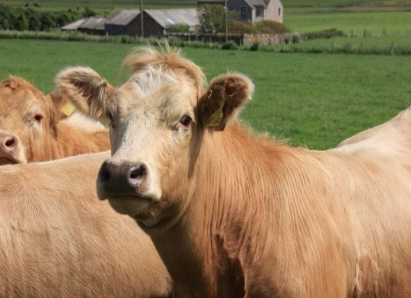

Polymerase Chain Reaction (PCR) testing for M. bovis
The Animal & Plant Health Agency (APHA) has validated a PCR test which can detect the bacterium responsible for bovine TB, Mycobacterium bovis (M. bovis) directly from tissue samples collected at post-mortem inspection.
The major advantage of this method is that a result is typically available within three weeks, whereas traditional microbiological culture (the ‘gold standard’ method) takes 6-22 weeks.
Note:
Currently, APHA TB laboratories are closely monitoring the performance of the PCR test as part of laboratory quality control checks of new diagnostic methods following their introduction. Whilst this monitoring of the PCR test is ongoing, samples from bovine slaughterhouse cases are tested by bacteriological culture in parallel with the PCR test. If the PCR test produces non-positive result, final outcome of the laboratory testing is not reported until culture has been completed.
PCR test 3 weeks
Culture 6-22 weeks
The M. bovis PCR test has advantages for the management of TB slaughterhouse cases by APHA
Slaughterhouse case (lesions typical of TB found in the carcase of an animal sent for private commercial slaughter)
Movement restrictions applied to the herd/flock of origin
M. bovis PCR test carried out on the tissue samples from the carcase
Lifting of movement restrictions sooner than if culture used to confirm or negate disease
Await culture result if sample from cattle
Negative
(+ check testing where required)
PCR test result within 3 weeks
APHA can inform the keeper and their private vet quicker, so that further action can be taken as soon as possible to control TB in the affected herd/flock
If culture negative
If culture positive
Positive
Previously 6-22 weeks to obtain a result using culture
How is APHA’s M. bovis PCR test used?
The M. bovis PCR test is used in Great Britain (GB) for tissue samples from carcases of:
Cattle* and other non-bovine animals such as camelids, goats, pigs, sheep and farmed deer that are removed as skin and/or blood TB test positive animals, direct contacts (DC) or clinical TB suspects, and cases where TB lesions are identified on diagnostic post-mortem examination in a veterinary laboratory;
TB slaughterhouse cases in cattle and non-bovines i.e. animals routinely sent for private commercial slaughter that have suspected lesions of TB at routine meat inspection; and
Domestic pets (cats and dogs) and exotic species of animals (e.g. in zoological collections) submitted to APHA for laboratory investigation.
* Since 02 March 2026, PCR testing is no longer performed on VL bovine samples from skin and blood TB test positive cattle, DCs and IRs.

Slide 2





What is PCR?
Polymerase chain reaction (PCR) is a molecular-based laboratory technique. It involves detecting small amounts of the genetic material (DNA) contained within all living organisms, by making millions of copies of a specific sequence of the target DNA, a process called amplification.
Tissue sample taken at post-mortem inspection
Target DNA extracted
Amplification using a PCR machine
DNA copies
Each M. bovis bacterium contains unique DNA which carries the genetic instructions for its development, function, growth and reproduction. PCR can identify tiny amounts of the DNA present within these bacteria and amplify it to produce a quantity which is then detectable.
How accurate is the PCR test?
In a validation study carried out by APHA, the M. bovis PCR test has been shown to produce equivalent results to the traditional microbiological culture method, for both bovine and non-bovine tissue samples.
Benefits of the PCR test | Limitations of the PCR test
The current “gold standard” for bTB diagnostic testing from tissue samples is traditional microbiological culture which takes 6-22 weeks to obtain a result. PCR test results are typically reported to the keeper within three weeks. | Whole genome sequencing (WGS) can’t be used directly on the PCR product as it requires DNA obtained from a pure microbial culture. This means that APHA can’t rely exclusively on the PCR test for case management and epidemiological analyses of TB breakdowns. To allow full investigation of the breakdown and identify the probable source of infection, subsequent culture is carried out on PCR test positive samples to allow WGS to be performed.
Instead of relying on culture results for confirmation or negation of M. bovis infection, PCR testing is now carried out on tissue samples taken from bovine and non-bovine slaughterhouse cases. If negative, herd movement restrictions can be lifted sooner without having to wait for culture results. In Wales, a clear herd test may be required before restrictions can be revoked.
The PCR test is cheaper to run per sample than microbiological culture. The process is semi-automated and exploits laboratory robotics to facilitate high throughput, whilst also minimising contamination and maximising traceability of samples.
Find out more about the M. bovis PCR test on the TB hub https://www.tbhub.co.uk/
April 2022

